Slide 1
Shell Bootcamp 2024 3 Reflections for Week 1
Sakshi Sharma
Date : 30-Aug-2024

Slide 2

About Me
Do the best you can, with what you have.

Slide 3

My learnings from this week!

Slide 4
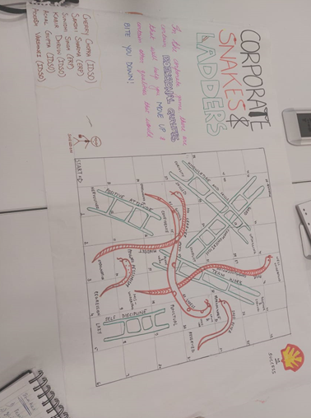
Learning 1 | My takeaways
We had a soft skills session on Professionalism, Grooming and Email writing etiquettes.
Key learning- Corporate grooming and Professional qualities like integrity and new world imperatives.
Key takeaway- Appropriate mannerism and presenting yourself professionally is of utmost importance to maintain a healthy environment in a company.
Energy sector just like any other sector requires communication with multiple people from different departments so presenting yourself appropriately is essential.

Slide 5
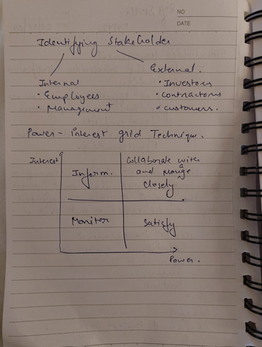
Learning 2 | My takeaways
Stakeholder management and Trust building.
Key learning- Identifying the type of stakeholders and managing relations with them.
Planned stakeholder management and building your trust helps you progress in your professional life.
There are a number of important stakeholders we interact with in the energy sector and we need to know how to manage relations with them.

Slide 6
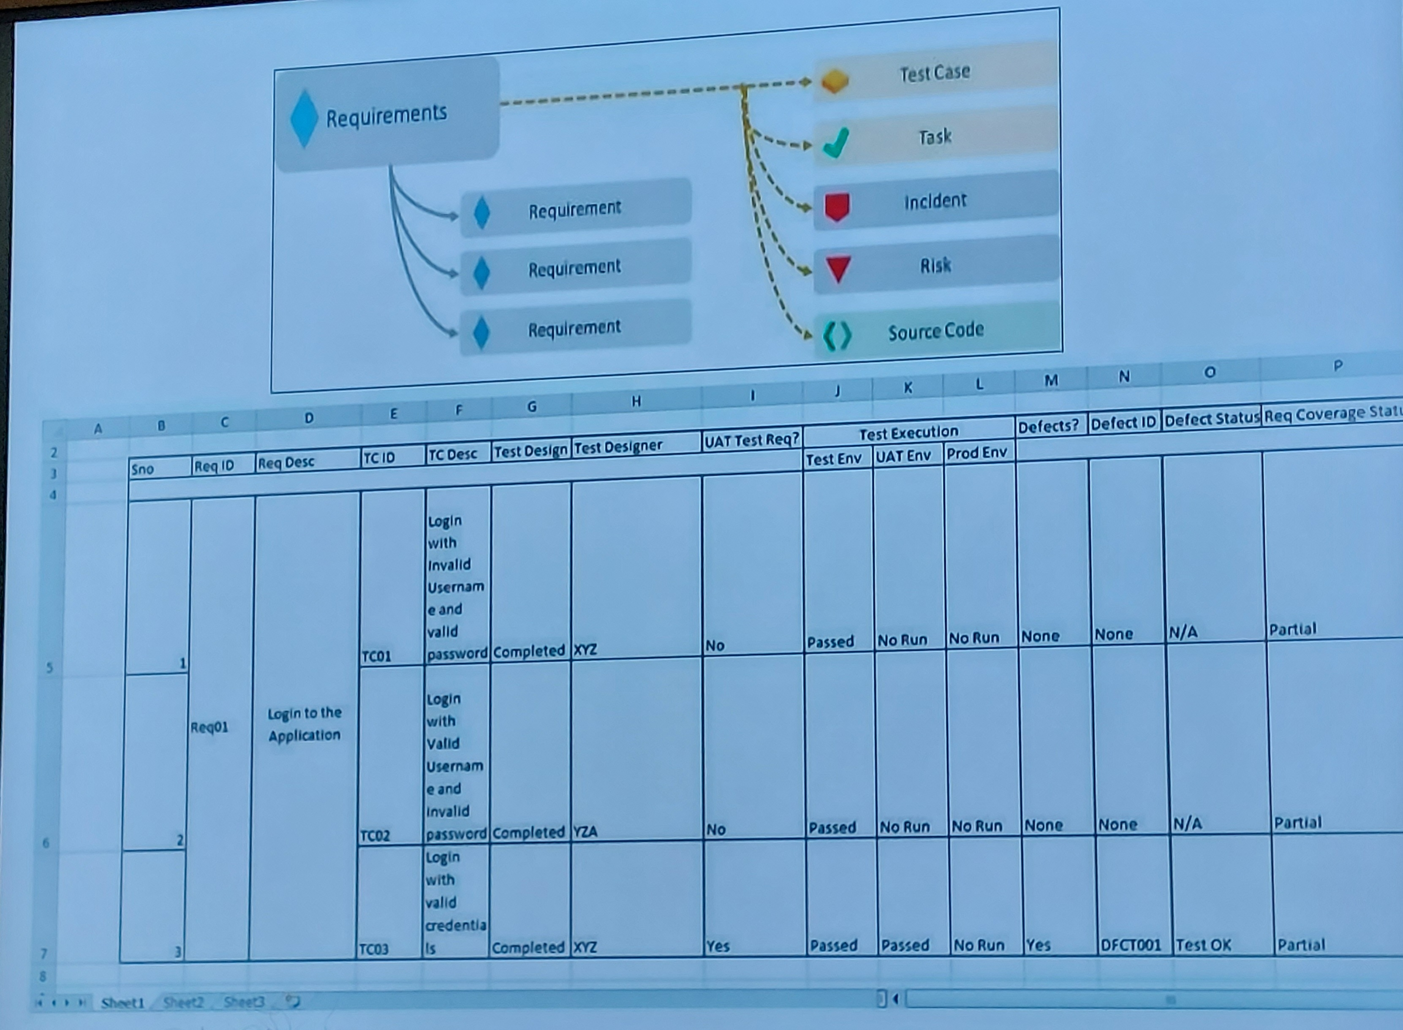
Learning 3 | My takeaways
We learnt about Agile and Business Analysis.
Requirement analysis and elicitation.
Knowing what the customer needs are is very important for the project’s success.
Requirement analysis in the energy sector is vital for ensuring projects meet specific needs, avoid risks, and support sustainability and compliance

Slide 7

Relevance of learnings for my organization

Slide 8
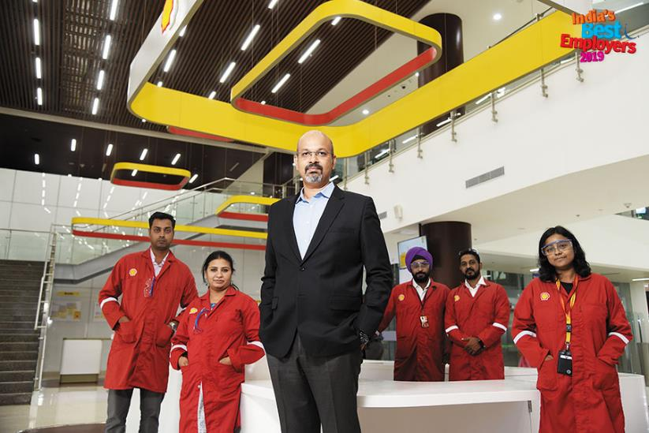
Learning 1 | Relevance for Shell
Shell implements professionalism by stating clear expectations to their employees and training them for the same. Shell adheres ethical practices while conducting their business.
Shell benefits from this as the reputation of the company is enhanced when the employee representing Shell shows professional qualities.

Slide 9
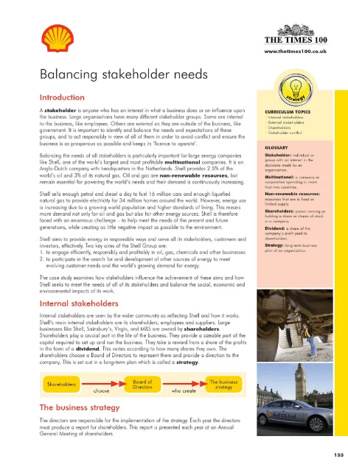
Learning 2 | Relevance for Shell
Shell implements stakeholder management by making strong and positive relationships with their stakeholders through consistent and respectful interaction, collaboration and support.
Shell benefits from this as planned stakeholder management leads to Informed decision making, improved communication and increased support for the company.

Slide 10
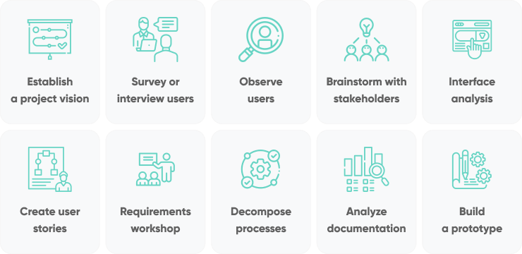
Learning 3 | Relevance for Shell
Shell evaluates the technical and financial aspects for each project and then design optimal solutions.
Shell benefits from these as conducting a thorough requirement analysis leads to project efficiency and cost savings which ultimately enhances company’s reputation.

Slide 11

Challenges in implementing learning

Slide 12
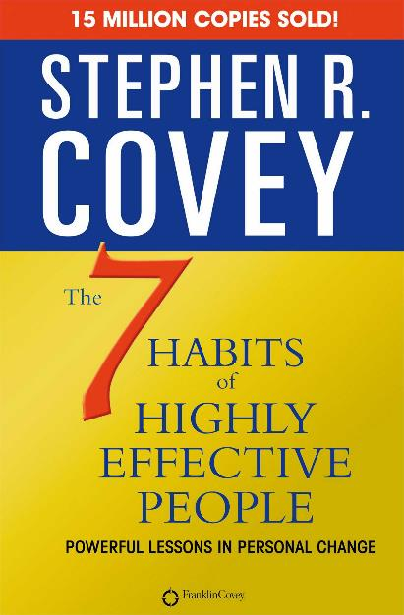
Challenge faced while implementing Learning 1
Having a positive attitude is one of the important attributes of professional mannerism but I tend to have negative thoughts from time to time. I plan to overcome them by interacting more with people who support me and read motivational books.

Slide 13
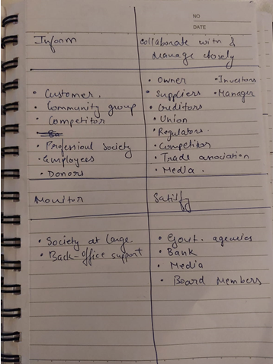
Challenge faced while implementing Learning 2
Understanding the level of importance of different stakeholders was challenging for me. I plan to overcome this by first identifying the type of stakeholder and carefully formulating a communication plan accordingly.

Slide 14
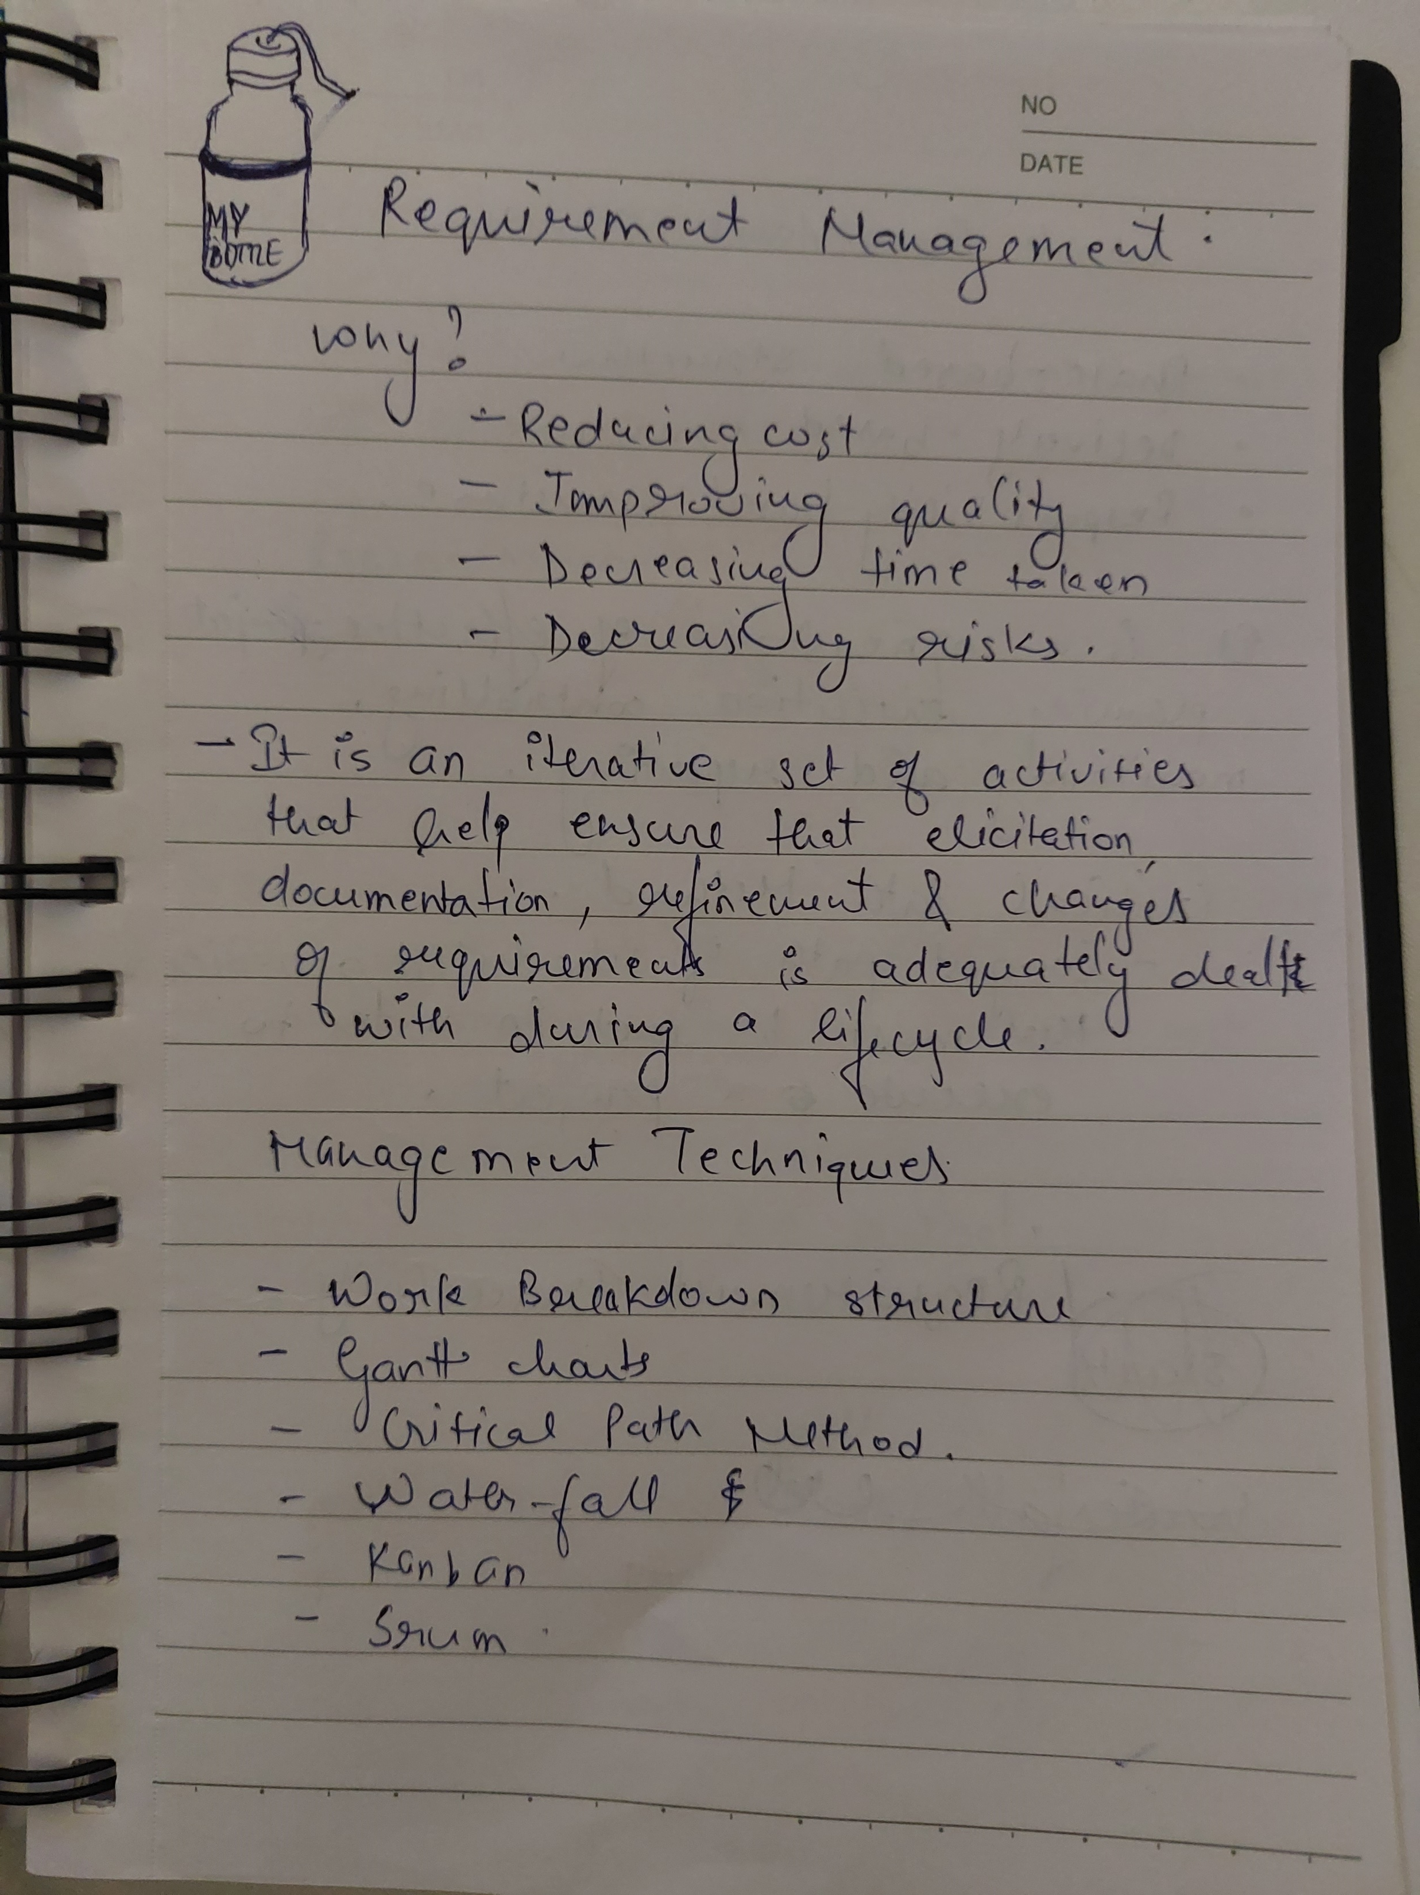
Challenge faced while implementing Learning 3
The main challenge faced by me and my team was during an activity where we were given the task to make paper airplanes. We immediately assumed the customer needs and started working on the task. We overcame this by having a thorough discussion with our teacher and first analyzing what exactly are the requirements of this project.

Slide 15

Action Plan

Slide 16
My Action Plan for this Week
Actions
Timeline
Status
Interacting with my peers and team members.
Setting up GTKYs with Shell employees and learning about their experience.
I plan to implement these actions right away and aim to build a good network in Shell within the next 2 to 3 months.
Met a few members from my Line of Business including my line manager and Buddy.

Slide 17

Learning is also Fun!

Slide 18
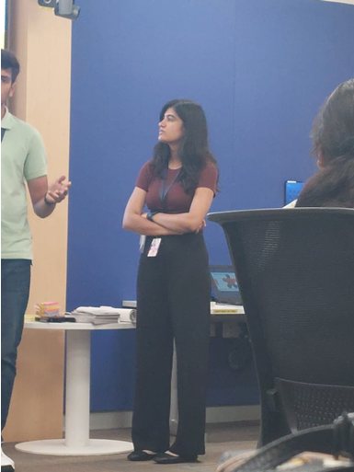
Learning is also Fun!
Our facilitator for Soft Skills, Dr. Padmshree conducted the sessions in fun manner while at the same time educating us.
We did a couple of role plays to understand Mobile etiquettes and Stakeholder Management.
To understand team work, we played a number game where you need to count to 10 but the order of people calling out numbers is random and if two people say the same number at the same time we needed to start again from 1. This incident turned out to be really funny as initially we were really struggling to even count to ten.
My teammate performing in a roleplay for stakeholder management

Slide 19

Summary
This week was full of fun activities which taught us basic soft skills needed to thrive in a workplace. Along with that we started our foundational training and learnt about importance of requirement analysis.
The topics that will be covered in the upcoming week include hands on training on Azure Devops.
This week we learnt about SCRUM and we will be implementing the same next week.

Slide 20
Thank You

